Slide 1
Literature review and preliminary actuator cylinder modelling of adjacent VAWTs
Angus Buck
Supervisors: Dr Ed Hart, Prof. Bill Leithead
Former supervisors: Peter Jamieson, Prof. J Michael R Graham.

Slide 2
Contents, or: VAWTs – why and how?
Different power gain mechanisms
Power gain illustration
The VAWT MRS
The Actuator Cylinder
Sharing my code ☺

Slide 3
Mechanisms of power gain in adjacent VAWTs
Wind Perpendicular to VAWT plane
Wind Oblique to VAWT plane
Source: Fluid dynamic mechanisms of enhanced power generation by closely spaced vertical axis wind turbines [1]

Slide 4
Mechanisms of power gain in adjacent VAWTs
Wind Perpendicular to VAWT plane
On upwind half of blade revolution:
Greater flow impedance
flow rate decrease
reduced power.
Flow direction altered
AoA more favourable for torque generation
increased power.
Net increase in power on upwind half.
Source: Fluid dynamic mechanisms of enhanced power generation by closely spaced vertical axis wind turbines
Notes:
More turbine so more impedance to the flow
Lateral velocity variously reversed and/or reduced
More favourable = lasts longer and torque is greater
Overall, increase dominates, net gain of power on this half

Slide 5
Mechanisms of power gain in adjacent VAWTs
Wind Perpendicular to VAWT plane
On upwind half of blade revolution:
flow impedance
reduced power
AoA better for torque generation
increased power
Net increase in power on upwind half.
On downwind half of blade revolution:
Flow can’t ‘escape’ laterally
greater flow rate through back
more power.
Source: Fluid dynamic mechanisms of enhanced power generation by closely spaced vertical axis wind turbines
Wind Perpendicular to
Notes:
Flow can’t escape laterally as the wake of the other turbine blocks it
To conserve mass, this means the flow rate must increase, pushing more air through the back, increasing power.
So overall, we have power gain all across the turbine.

Slide 6
Mechanisms of power gain in adjacent VAWTs
Wind Oblique to VAWT plane
At small angles:
Wake of front turbine cannot fully develop
sight decrease in power
Back turbine is hit by accelerated flow from around front turbine
increase in power
Net increase in power
Source: Fluid dynamic mechanisms of enhanced power generation by closely spaced vertical axis wind turbines
Wind Perpendicular to

Slide 7
Mechanisms of power gain in adjacent VAWTs
Wind Oblique to VAWT plane
At small angles:
Wake of front turbine cannot fully develop
sight decrease in power
Back turbine is hit by accelerated flow from around front turbine
increase in power
Net increase in power
At large angles:
Front turbine wake further obstructed
even less power
Back turbine shadowed by front turbine
now decreased in power
Source: Fluid dynamic mechanisms of enhanced power generation by closely spaced vertical axis wind turbines
Wind Perpendicular to

Slide 8
VAWTs – why and how?
Different power gain mechanisms
Power gain illustration
The VAWT MRS
The Actuator Cylinder
Sharing my code ☺

Slide 9
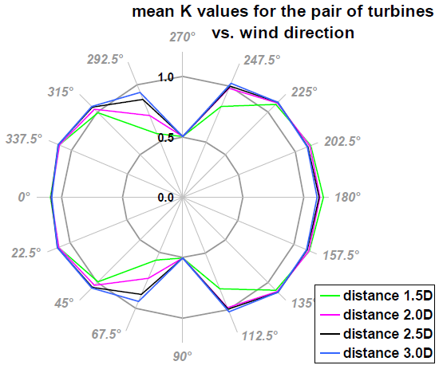

Power gain
Significantly more power in pairs
Good gains at multiple separation distances
Strong yaw insensitivity
Experimental Validation:
IDW@1.3D: 13.1% gain
IDW@1.2D: 13.6% gain
IUW@1.3D: 15.9% gain
IDW
IUW
Image source: Fluid dynamic mechanisms of enhanced power generation by closely spaced vertical axis wind turbines
Validation source: Experimental validation of the power enhancement of a pair of vertical-axis wind turbines
Notes:
IUW increases in power for small angle deviations?
2.5D spacing in particular only had a small drop relative to 3D spacing, while going to 2D and 1.5D resulted in significant drops.
3D seems quite far apart - at which point do you stop getting the blockage benefits and your power starts decreasing again?
[1] concludes idw configuration at 3D spacing gives the same average performance over a wide range (over 90 degrees) around its ideal 180 degree case.
[1] take the assumption that the back turbine would see a wind speed less that the cut-in speed and so not rotate at all, and thus trivially find the front turbine’s power is exactly that of an isolated turbine’s, an increase compared to the case of the highly-but-not-fully shadowed back turbine.

Slide 10
VAWTs – why and how?
Different power gain mechanisms
Power gain illustration
The VAWT MRS
The Actuator Cylinder
Sharing my code ☺

Slide 11
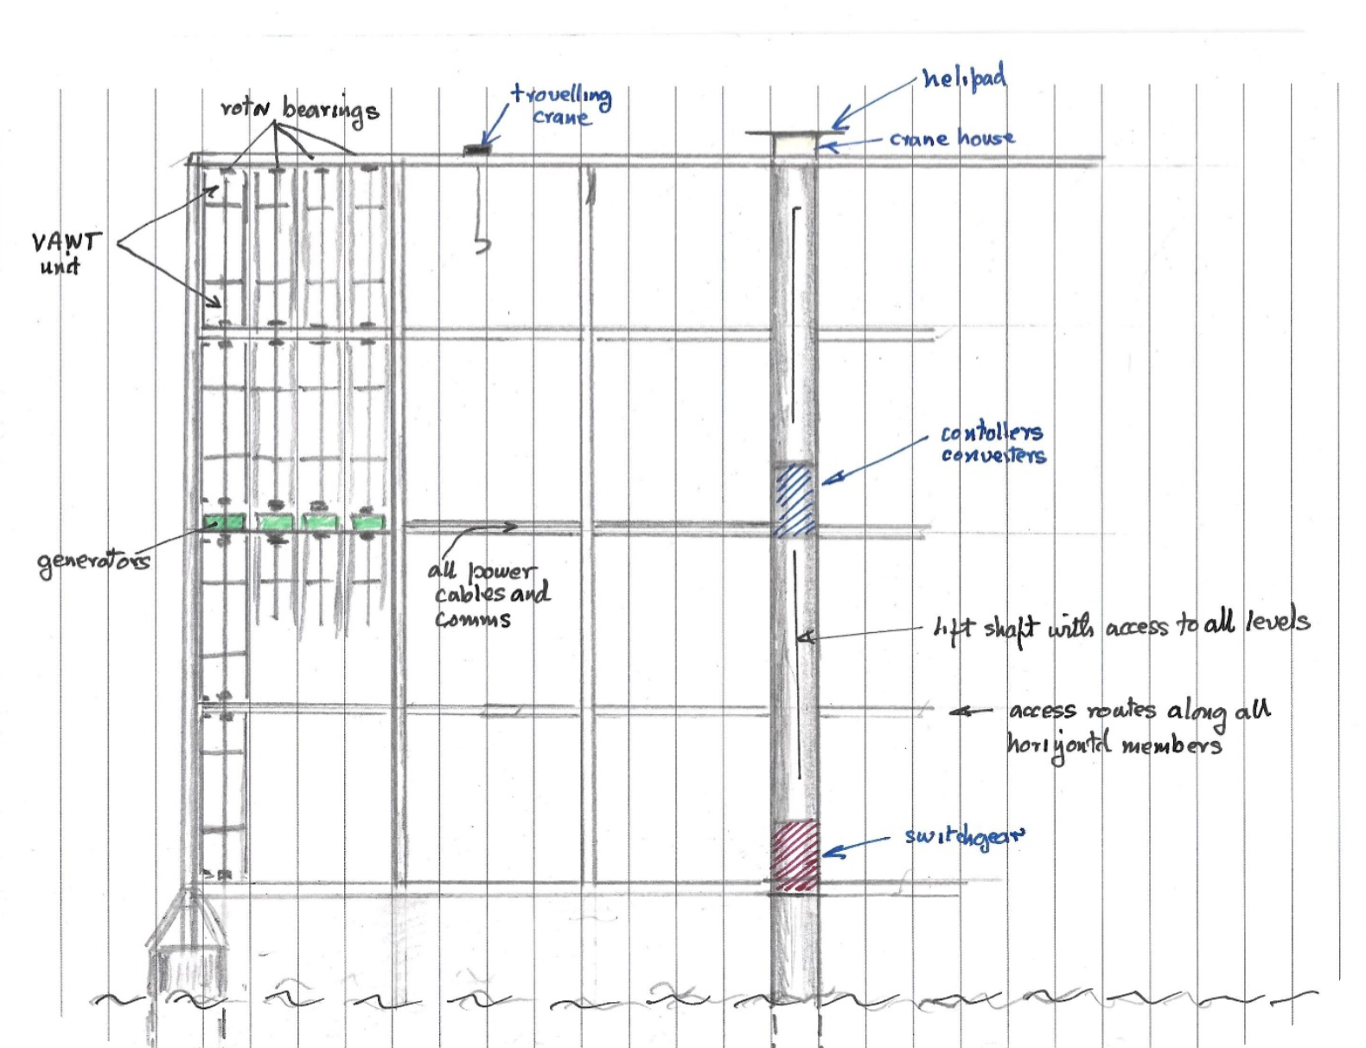
VAWT MRS
48MW floating offshore MRS
4*24 500kW rotors
17.73m*88.65m rotor
Typical MRS advantages
VAWT advantages:
Connections at top/bottom of rotor (causing blockage instead of drag)
4x fewer generators
VAWT mitigations:
high aspect ratio contained easier
pseudo-helical torque input
Reference: Development of a multi rotor floating offshore system based on vertical axis wind turbines
Notes:
Mention you’ve been out the loop for a while and this info may be out of date ^_^;
~350m*425m (150,000m²) swept area total
Blockage = flow concentration

Slide 12
My Research: MRS
Very tight spacing planned
Impact on power
Impact on yaw sensitivity
Impact on wakes
Rotation direction layout of a long row
Consider 3D effects
Reference: Development of a multi rotor floating offshore system based on vertical axis wind turbines

Slide 13
VAWTs – why and how?
Different power gain mechanisms
Power gain illustration
The VAWT MRS
The Actuator Cylinder
Sharing my code ☺

Slide 14
The Actuator Cylinder
Notes:
(sum of v*Δp at each point, *2πR)

Slide 15
The Actuator Disk
A₀U₀
Idealise rotor as flat disk
Consider flow from far upwind
to far downwind
Mass flow conservation:
A₀U₀ = A₁U₁ = A₂U₂
Momentum conservation:
(ρU₀ - ρU₂)AU = rotor force = A₁q
q is also the difference in static air pressure Δp either side of the rotor
Power extracted: P = (A₁q)U₁
A₁U₁
A₂U₂
Notes:
(THIS IS POWER EXTRACTED FROM WIND, NOT POWER GENERATED BY TURBINE (BASICALLY BETZ I THINK) I THINK)

Slide 16
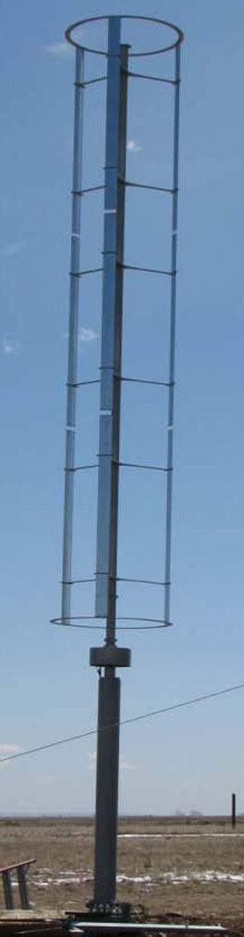
The Actuator Cylinder
Instead of idealising rotors as disk…
…we idealise rotors as a cylinder…
…and approximate cylinder by a 2D slice
Image source: Wind Turbine Safety and Function Test Report for the Mariah Windspire Wind Turbine
Notes:
(sum of v*Δp at each point, *2πR)
(THIS IS POWER EXTRACTED FROM WIND, NOT POWER GENERATED BY TURBINE (BASICALLY BETZ I THINK) I THINK)

Slide 17
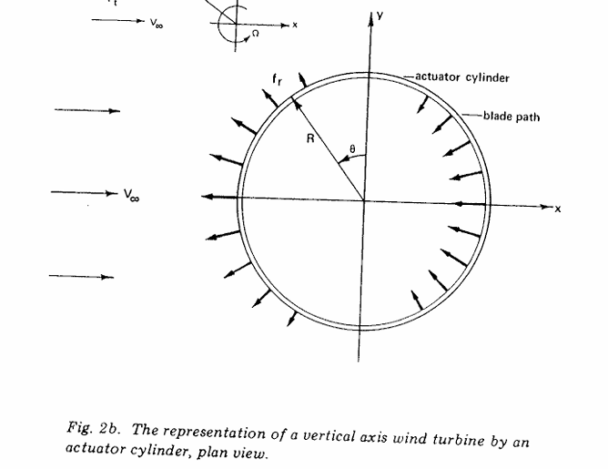
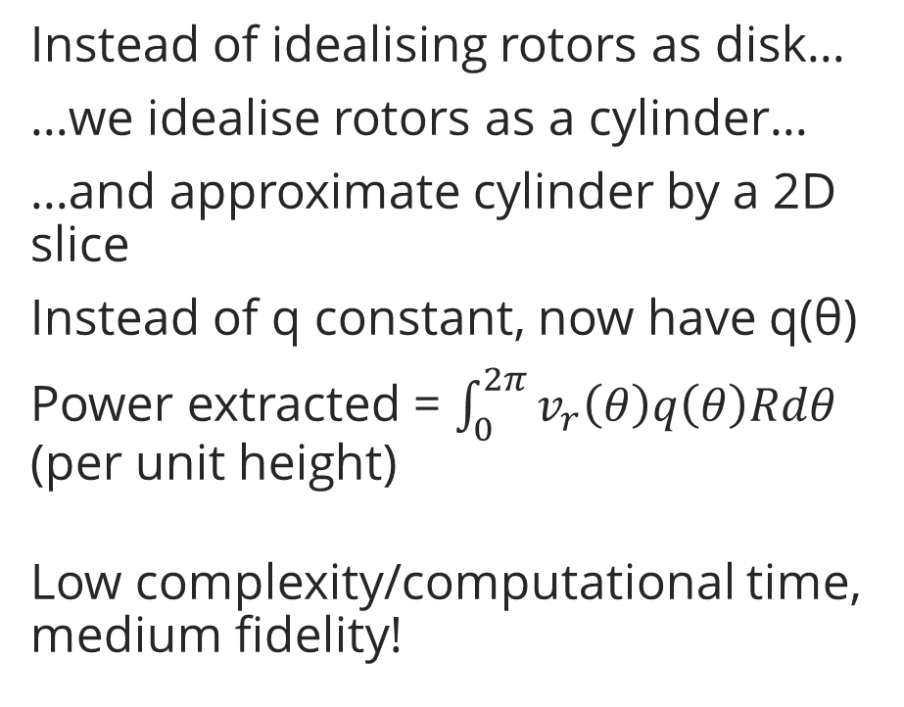
The Actuator Cylinder
Instead of idealising rotors as disk…
…we idealise rotors as a cylinder…
…and approximate cylinder by a 2D slice
Instead of q constant, now have q(θ)
Power extracted = $\int_{0}^{2π}{v_{r}\left(θ\right)q\left(θ\right)Rdθ}$ (per unit height)
Low complexity/computational time, medium fidelity!
Image source: The Actuator Cylinder: A Flow Model for Vertical Axis Wind Turbines
Notes:
(sum of v*Δp at each point, *2πR)
(THIS IS POWER EXTRACTED FROM WIND, NOT POWER GENERATED BY TURBINE (BASICALLY BETZ I THINK) I THINK)

Slide 18
The Actuator Cylinder
Solve mass + momentum equations as before
Obtain nonlinear Poisson equation for wind pressure p
Deduce equations for wind velocity perturbations w_{x}, w_{y}
Solution has linear and nonlinear parts
Linear solutions, prescribed q: computational calculation
Nonlinear approximation: …with correction term
Nonlinear solution: …with iterative loop
Calculate q from w_{x},w_{y} & aerofoil data: …with (another) iterative loop
functions of q(θ)
Source: Actuator Cylinder Theory for Multiple Vertical Axis Turbines
Source: The Actuator Cylinder – A Flow Model for Vertical Axis Wind Turbines
Notes:
(Gain equations for wind’s the velocity and pressure perturbations)
Deduce wind velocity perturbation eq^{n} FROM pressure eq^{n}

Slide 19
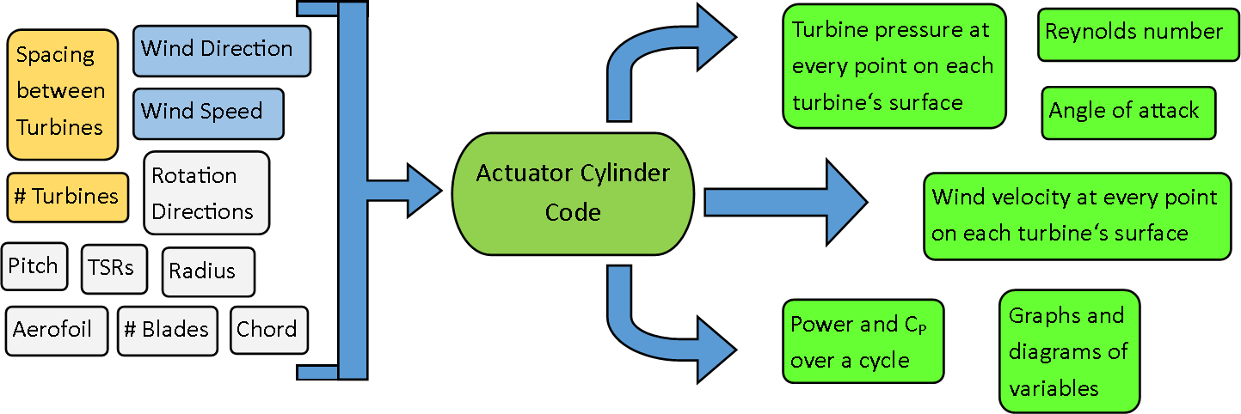
My Research: Code!

Slide 20

My Code
Based on Andrew Ning’s work
Written in Matlab
Can batch-run + compare different setups
Current version: linear, q from aerofoil data
github.com/AngusBuck/
Multiple-Actuator-Cylinder
Reference: Actuator Cylinder Theory for Multiple Vertical Axis Turbines

Slide 21
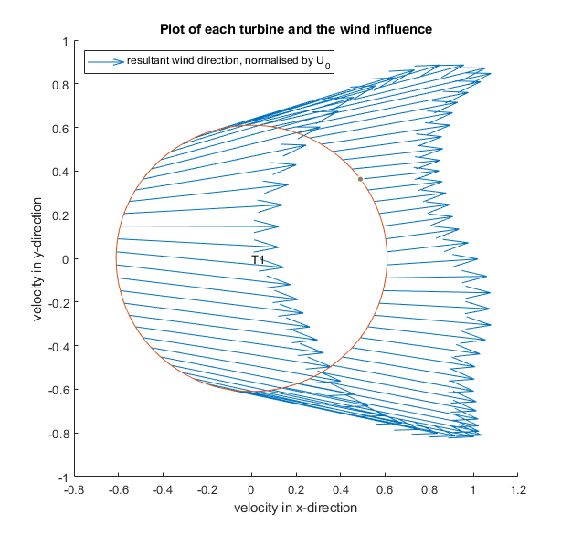
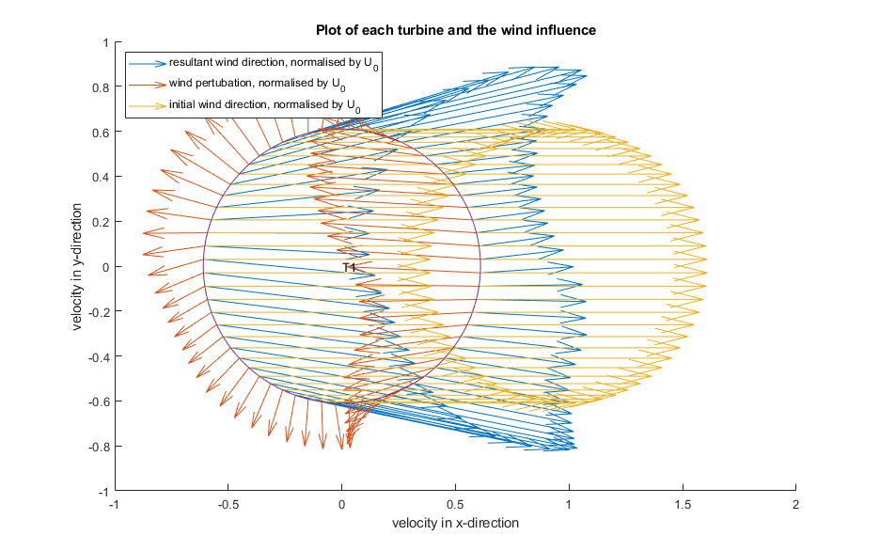
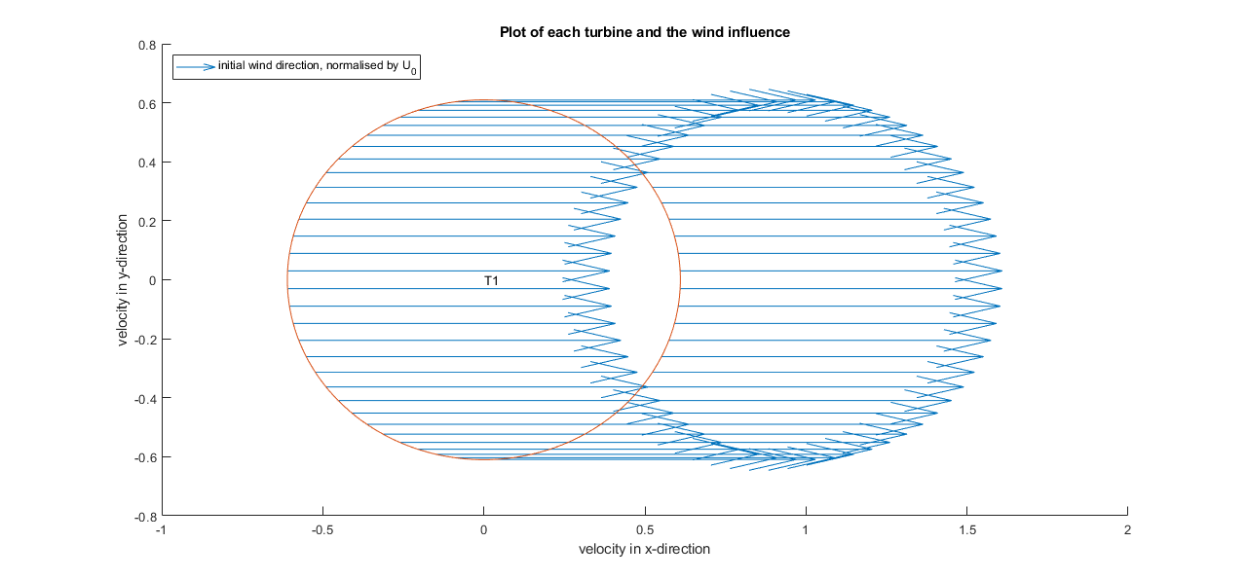
My code: qualitatively good

Slide 22
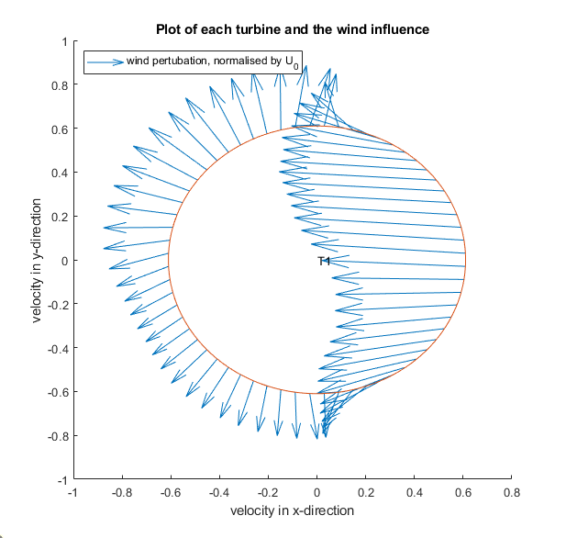
My code: qualitatively good

Slide 23
My code: qualitatively good

Slide 24
My code: qualitatively good

Slide 25
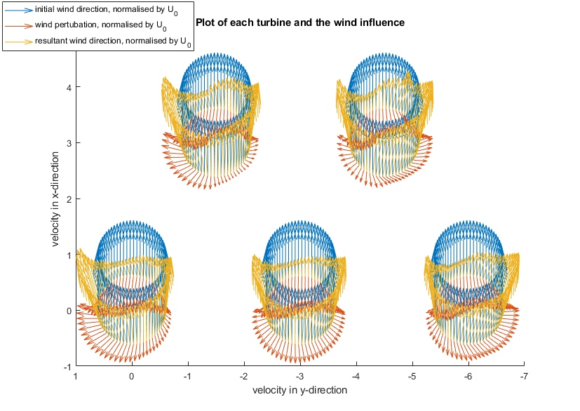
My code: qualitatively good

Slide 26
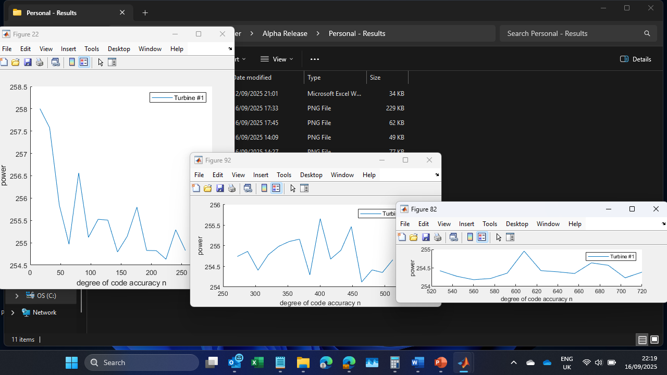
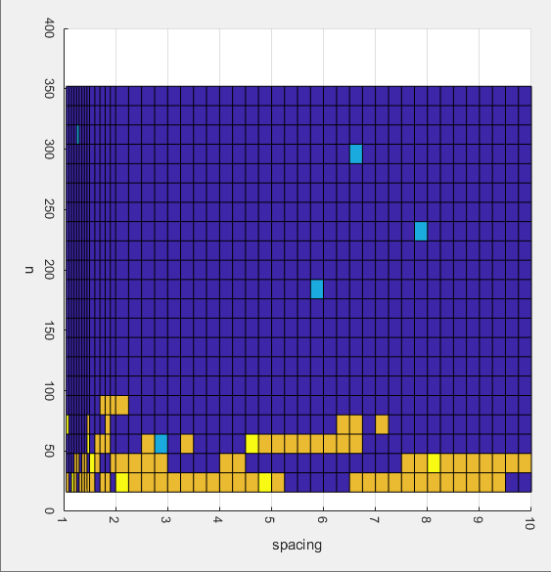
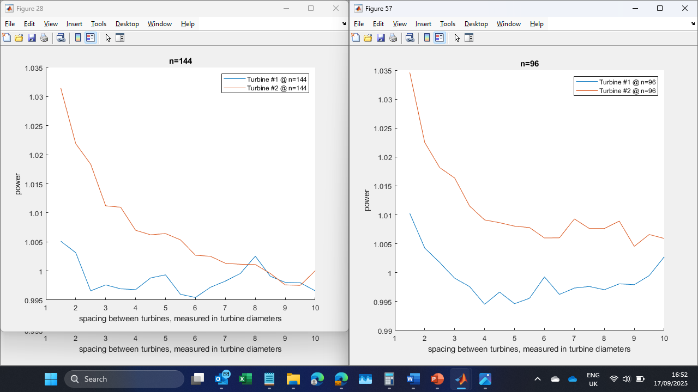
My code: quantitative issues

Slide 27
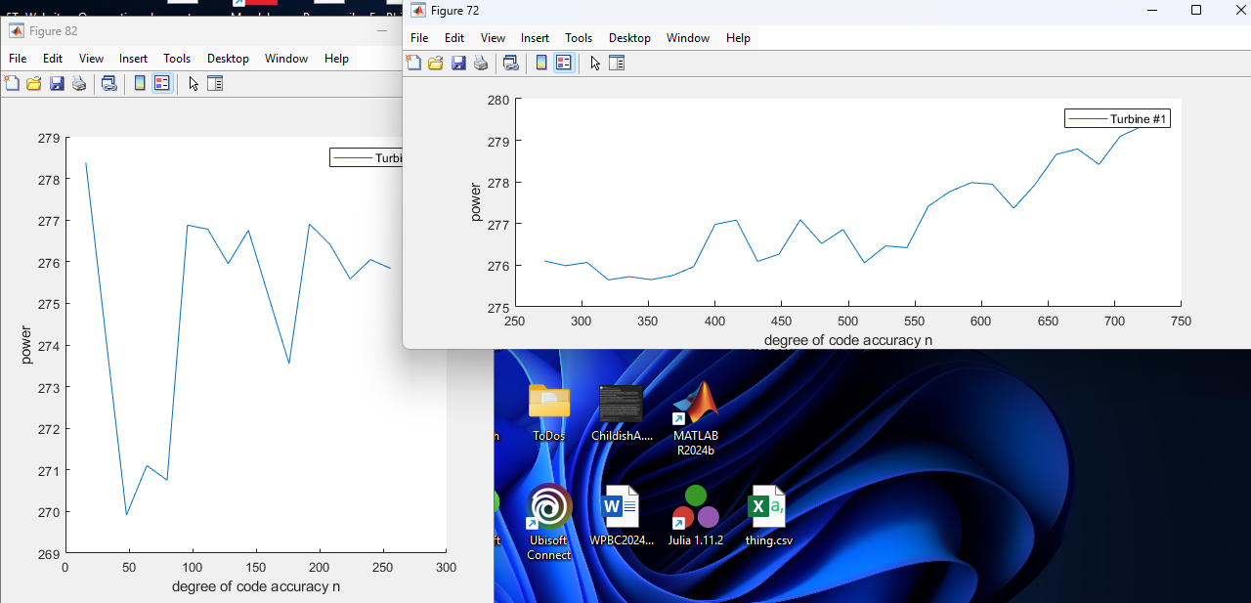
My code: quantitative issues

Slide 28
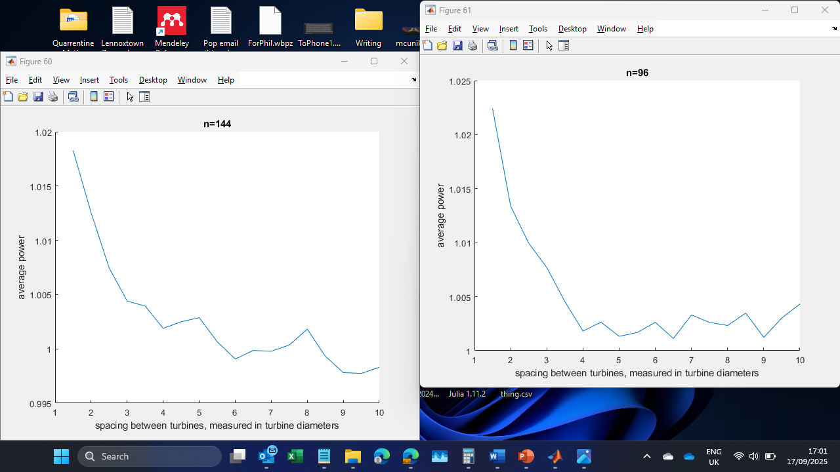
My code: quantitative issues

Slide 29
My code: next steps
Computational: make fsolve converge
Mathematical: nonlinearities
correction term?
full nonlinear?
Physical:
virtual camber
better wake model
3D adaptation
Notes:
(Are there other bits of physics that I’d expect AC to get wrong? Lack of wake expansion => better results at tight spacings, or smth?)
(did I compare against Araya/ACFOAM? I should do that)

Slide 30
Things I didn’t have time for
Other Interesting Physics
Rotation direction combos
Wake con/divergence
Tip-speed ratios
Other Investigation Topics
Does oblique wind increase power?
How close is “paired”/”isolated”?
How long a row before properties stop changing?
Connect to LCoE model
General guidelines/principles for VAWT pairs/rows
Notes:
Recall that The wake of a VAWT deflects laterally in the direction of the upwind-travelling blade.
Stronger/different aerodynamic effect => stronger/different wake that side
Related to Magnus effect/VAWT side force
IUW/IDW configuration will have converging/diverging wakes respectively.
IUW wake is narrower (~1.1 eq.Ø vs ~1.7 eq.Ø) and taller
Colliding wake has to escape vertically
“Appears to be a cancellation mechanism enhancing the dissipation of the turbulence for the [IUW] configuration”
Opportunities:
Narrower wake has benefit for farms
Possibility of enhanced wake recovery for IUW?
Possibility of reduced turbulence?
Power benefit?

Slide 31
Summary
VAWT pair power increases from AoA gains + blockage gains
VAWT MRS takes strengths of VAWTs and mitigates their weaknesses
An actuator cylinder models VAWTs with low complexity and medium accuracy
My own code…
is qualitatively correct
will soon be brought up to standard
will be improved to well model the MRS
is available ☺

Slide 32
Thank you for listening!
github.com/AngusBuck/
Multiple-Actuator-Cylinder
Please come ask me Qs/share thoughts at my poster or the dinner this evening! ☺
Notes:
Happy to answer any questions I can in the question session, or else please chat to me during the conference dinner this evening ^_^

